Slide 1


Progressive Artistries
Red Devils

Slide 2
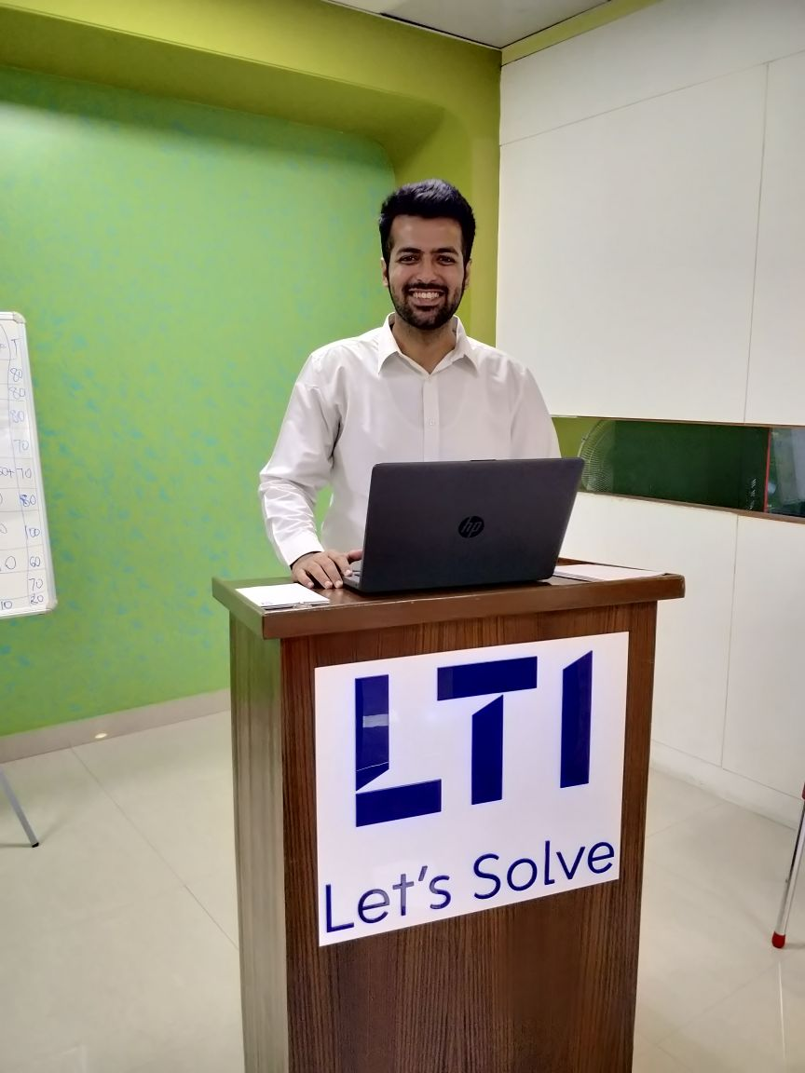


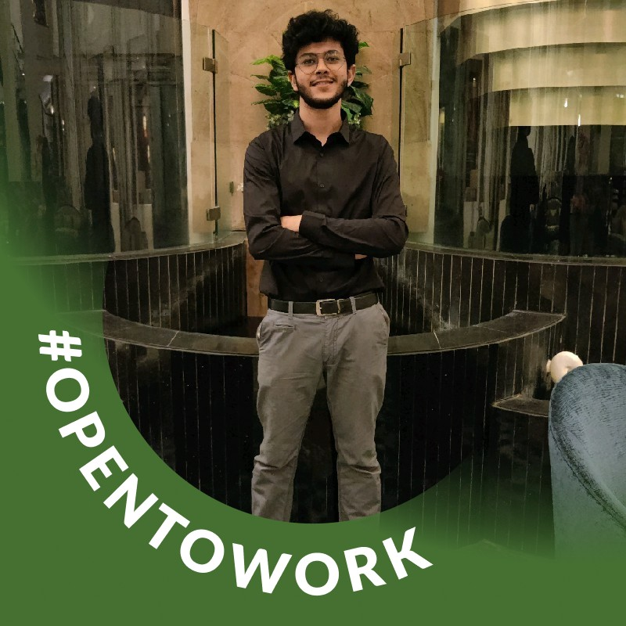


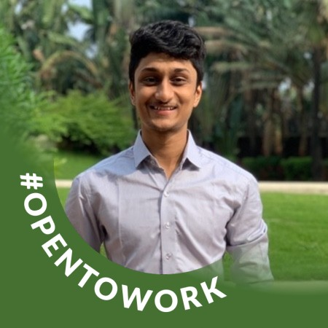
OUR TEAM
Niveditha CA
Mohit Khatri
Parth Gandhi
Karan Shah
Gisha Gopal
Darshil Vora
Kartik Ashok

Slide 3
PROJECT CHARTER
Motivate Team Members
Plan project milestones and timelines
PROJECT MANAGER
RESPONSIBILITIES
Conflict resolution
Time Management
Allocate tasks to the team members
Monitor Weekly Progress
Coordinate team project activities
Notes:
30 sec

Slide 4
PROJECT CHARTER
Prepare & present the project plan to the professor and panel members on 27th April.
Build a team to discuss the plan to start a non-profit organization
PROJECT OBJECTIVES
Discuss an attainable and measurable goals with team members
Receive 80% of target funding by 27th April 2022
Notes:
1 min

Slide 5
PROJECT CHARTER
Get 60%-80% funding commitment by April 27, 2022
Complete the final presentation within 40 minutes
SUCCESS CRITERIA
Getting selected by Panel

Slide 6
PROJECT CHARTER
Inability to convince the panel members
RISKS
Language barrier
Team Members not contributing equally
Resistance from University
Lack of funding

Slide 7
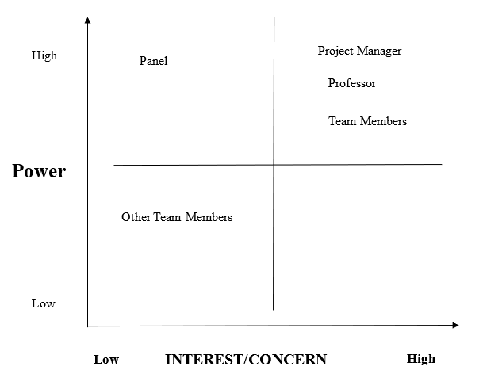
STAKEHOLDER MATRIX
(/)
(+)
(+)
(+)
(+)

Slide 8
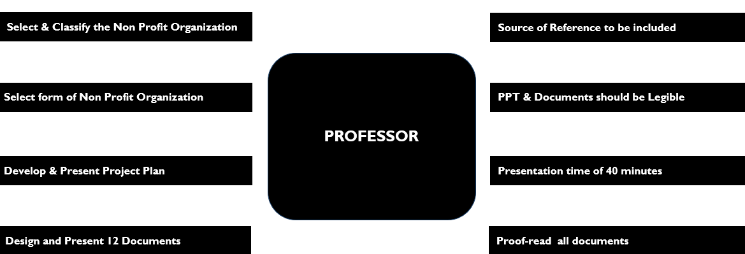
REQUIREMENTS - PROFESSOR
Notes:
4 mins in total for all requirements

Slide 9

REQUIREMENTS - TEAM MEMBERS
Agree & finalize proposed Non-Profit Organization
Decide suitable location that is feasible for all
Meet every week to make progress on project
Share updates via Zoom meetings regularly with team

Slide 10
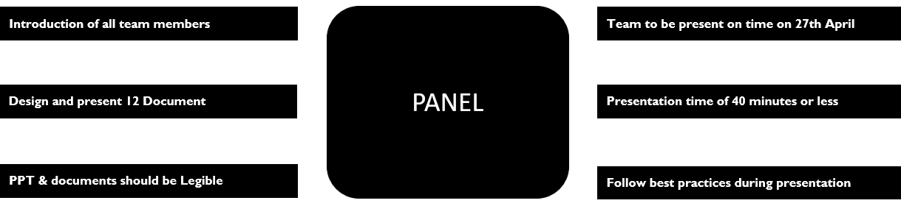
REQUIREMENTS - PANEL

Slide 11

REQUIREMENTS - OTHER TEAM MEMBERS
Receive clarification to questions asked
PPT should be legible

Slide 12

REQUIREMENTS - PROJECT MANAGER
Attend all meetings
Provide timely updates on any risk
Keep posted on progress

Slide 13
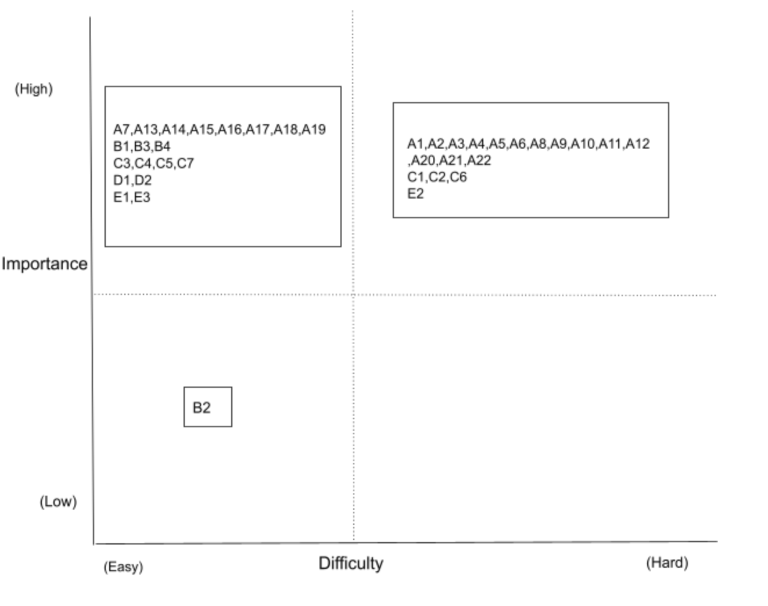
REQUIREMENTS MATRIX
DIFFICULTY (HARD) VS IMPORTANCE (HIGH)
A2, A3, A4, A5 - Non-Profit Organization
A1 - Develop a Project Plan
C1, C6 - Presentation Delivery
DIFFICULTY (EASY) VS IMPORTANCE (HIGH)
A7 - Project Charter
B1 - Team to agree upon Non-Profit Organization
DIFFICULTY (EASY) VS IMPORTANCE (LOW)
B2 - Location selection

Slide 14
SCOPE OF PRODUCT
Key requirements of the project:
TEAM MEMBERS
1. Agree on a proposed non-profit within the 8 categories.
2. Decide a suitable location that is feasible for all.
PANEL
1. Team to formulate a well-prepared presentation of 40 minutes or less on April 27, 2022.
2. Team should deliver all 12 documents as per project plan.
3. All team members to be present on time (by 5 PM EST) on April 27, 2022.
PROJECT MANAGER
1. Attend all meetings.
2. Provide timely updates of any risks.

Slide 15
SCOPE OF PROJECT
Key deliverables of the project
1.2 Taxonomy
1.2.1 Research
Analyze and explore different taxonomies
1.2.2 Discussion
Talk over and study the different taxonomies
1.2.3 Finalize
Once the discussion with other team members has been completed, finalize the Taxonomy for the non-profit organization

Slide 16
SCOPE OF PROJECT
Key deliverables of the project
6. Presentation
6.1 Rehearsal
Practice presentation based on given requirements
6.2 Printing Material
Print all the documents and make 2 copies
6.3 Outfit
Decide business formal outfits for the presentation
6.4 Final Presentation
Deliver presentation as planned

Slide 17
OUT OF SCOPE
Conducting workshops
Hiring employees
Contacting the social media influencers
Choosing location
Selecting vendors

Slide 18
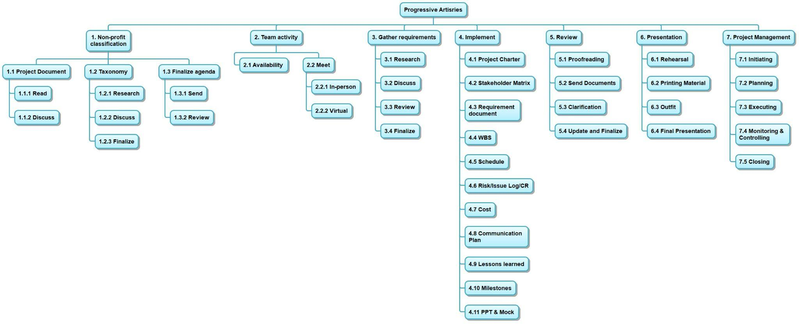
WBS

Slide 19
WBS

Slide 20
WBS

Slide 21
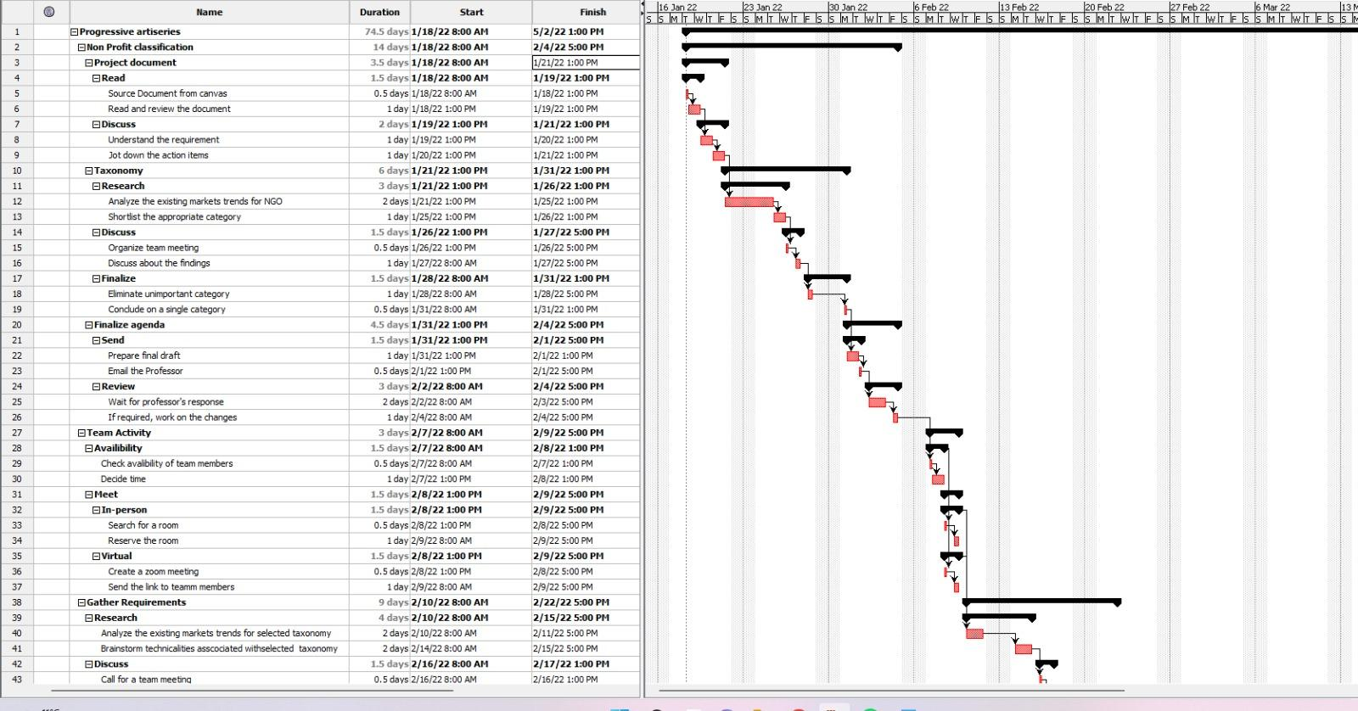
WBS SCHEDULE

Slide 22
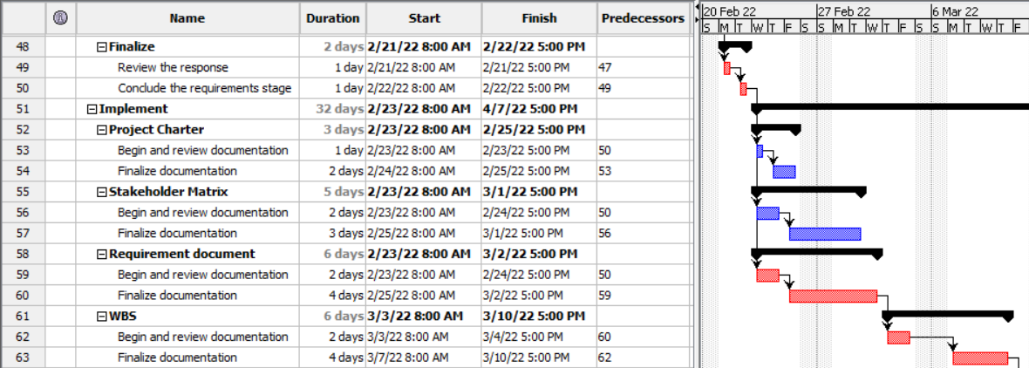
WBS SCHEDULE

Slide 23
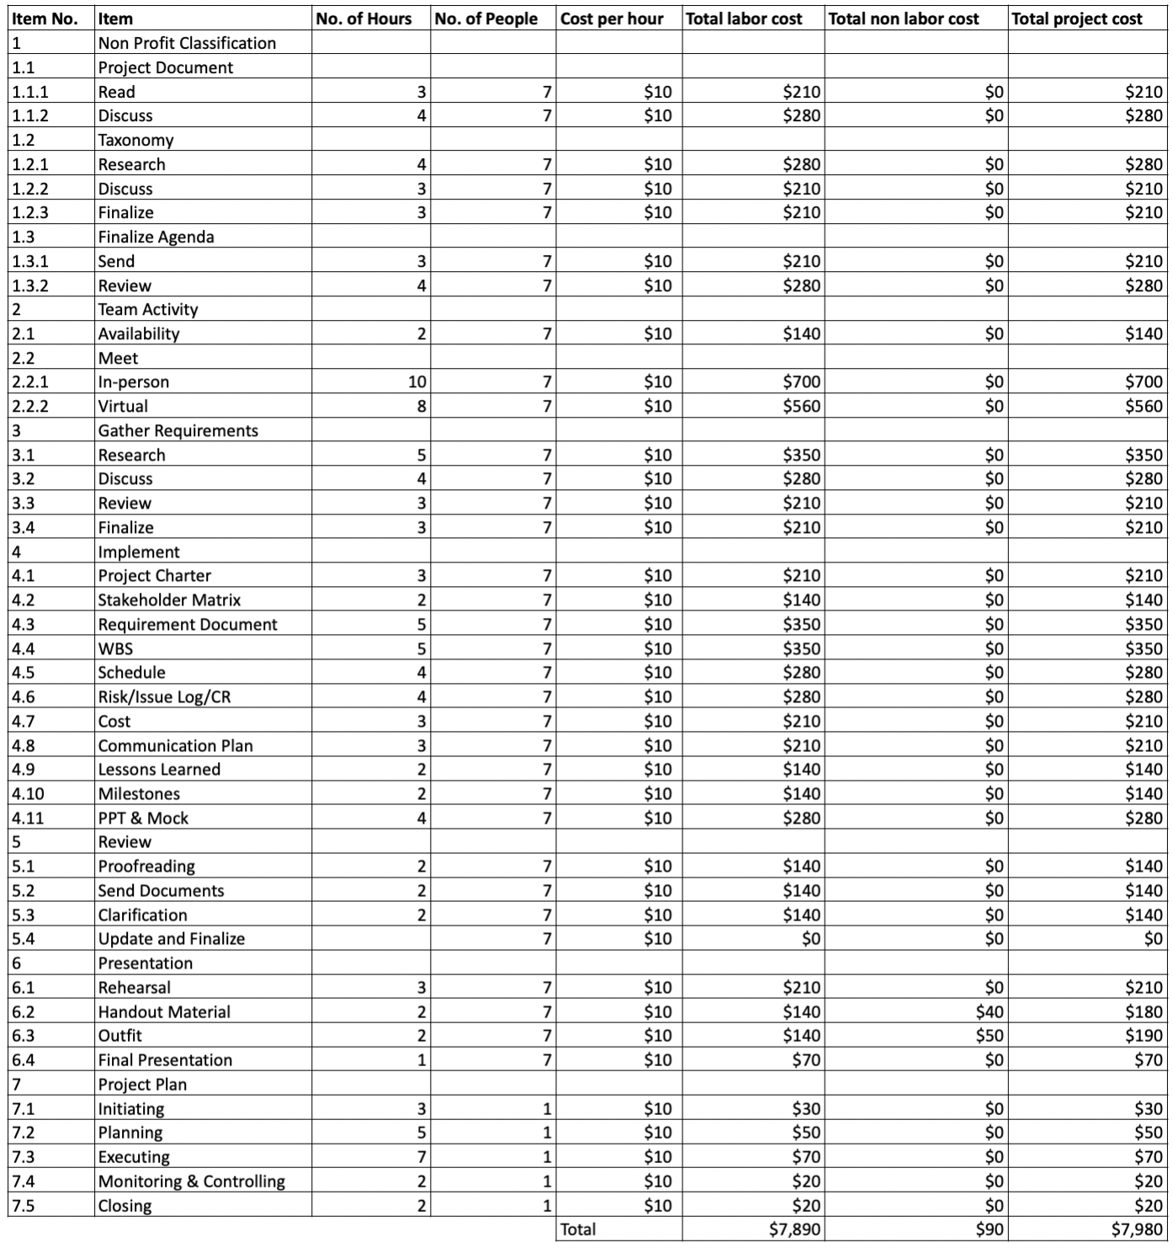
COST ESTIMATE

Slide 24
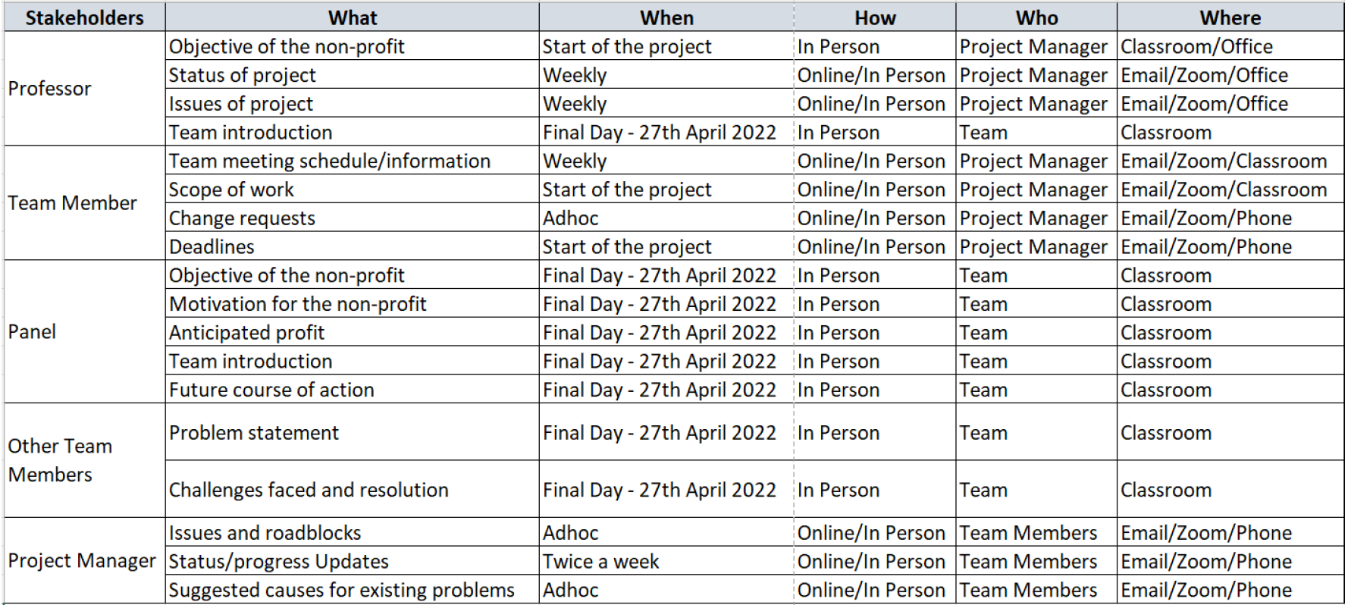
COMMUNICATIONS PLAN

Slide 25
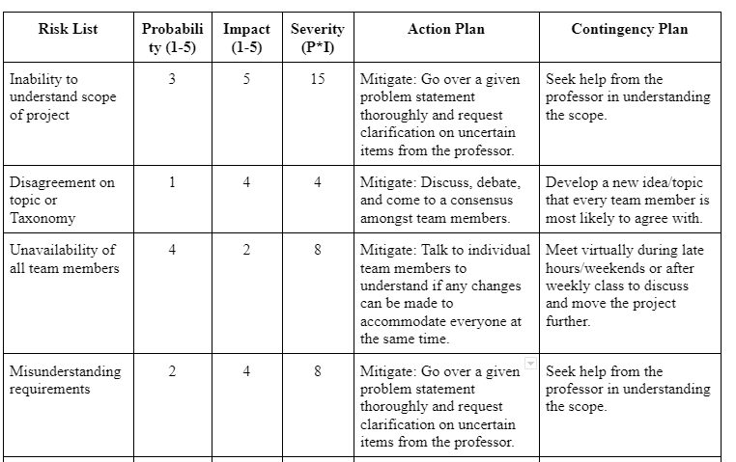
RISK MATRIX (PROBABILITY/IMPACT)

Slide 26
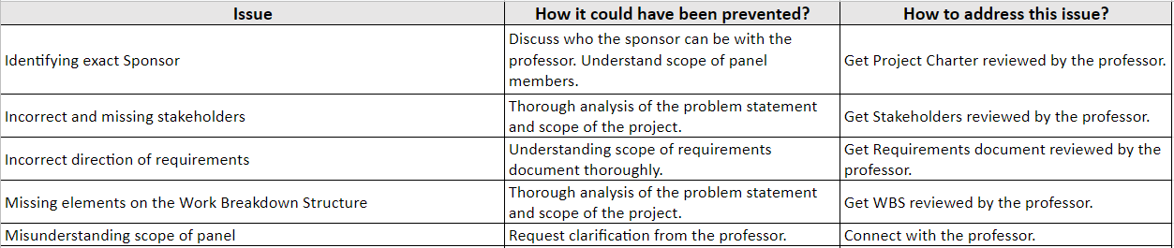
ISSUE LOG

Slide 27
The only thing that never changes is that….
Project will have changes!!

Slide 28
CHANGE REQUEST
Date Request Submitted: 03/16/2022
Title of Change Request: Milestones
Change Order Number: 0001
Submitted by: Prof. Herszon
Description of change requested:
Milestones needs to be included as part of scheduling/separate document

Slide 29
CHANGE REQUEST
Date Request Submitted: 03/25/2022
Title of Change Request: Weekly Schedule
Change Order Number: 0002
Submitted by: Project Manager (Mohit Khatri)
Description of change requested:
The meeting schedule of the team needs to be updated. The team would require to meet more often in order to complete the project within the deadline

Slide 30
MILESTONES
^{January 2022}
Form a team to create a project plan for non profit organization
Finalizing the taxonomy for the non profit organization
Research and gather requirements for creating the project plan
Create the 12 documents as part of the project plan
Create a presentation describing the project plan
^{April 2022}

Slide 31
LESSONS LEARNED
Process Group | Start Doing | Stop Doing | Continue Doing
Initiating |  | Be careful not to assume stakeholder needs.
Planning | Be mindful of stakeholder requirements when preparing proposals for research grants and permits. | Stop planning beyond the scope of the project
Planning | Plan and schedule the timeframe for submitting documentation. | Procrastination | Meet regularly to discuss progress and stay on track as per the deadlines
Executing |  | Do not divide work | Collaborate with the team members instead of dividing work

Slide 32

CONCLUSION / QUESTIONS

Slide 33
THANK YOU

